Slide 1
Mid Point Circle Algorithm

Slide 2
Derivation

Slide 3
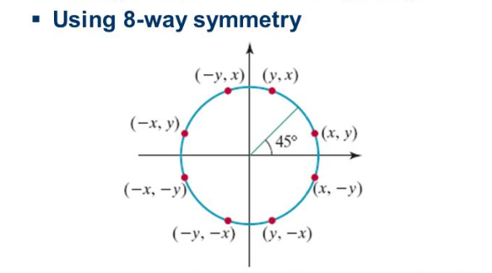

Slide 4

Possible next point: ($x_{k}$ +1 , $y_{k}$) or ($x_{k}$ +1 , $y_{k}−1$)
Mid point =$(\frac{x_{k}+1+x_{k} +1 }{2}$ , $\frac{y_{k}+y_{k}−1}{2}$)
Mid point = ( $x_{k}$ +1 , $y_{k}$-$\frac{1}{2}$)
We know,
Circle equation: $x^{2}$+$y^{2}$ =${ r}^{2}$
Decision Parameter, $P_{k}$ = (${x_{k}+1)}^{2}$ + ${(y_{k}−\frac{1}{2})}^{2}$- ${ r}^{2}$
Next Decision Parameter,
$P_{k+1}$ = ( $x_{k+1}$+ 1)² + ( $y_{k+1}$ - $\frac{1}{2})²$ - ${ r}^{2}$

Slide 5

Now,
$P_{k+1}$ - $P_{k}$ = ( $x_{k+1}$+ 1)² + ( $y_{k+1}$ - $\frac{1}{2})²$ - ${ r}^{2}$- (${x_{k}+1)}^{2}$ - ${(y_{k}−\frac{1}{2})}^{2}$+ ${ r}^{2}$
= [($x_{k}+1)+1]$² + ${(y_{k+1}−\frac{1}{2})}^{2}$- (${x_{k}+1)}^{2}$- ${(y_{k}−\frac{1}{2})}^{2}$ [after eliminating ${ r}^{2}]$
= (${x_{k}+1)}^{2}+1+2(x_{k}$ +1) + $y_{k+1}²$+ $\frac{1}{4}$ - $y_{k+1}$ - ${{(x}_{k}+1)}^{2}− y_{k}^{2}−$ $\frac{1}{4}+y_{k}$
$P_{k+1}$ - $P_{k}$ = $2(x_{k}$ +1) + ($y_{k+1}²$ - $y_{k}^{2})−( y_{k+1}−$ $y_{k})$ + 1 [after eliminating (${x_{k}+1)}^{2},$ $\frac{1}{4}$]
$P_{k+1}$ = $P_{k}+$ $2(x_{k}$ +1) + ($y_{k+1}²$ - $y_{k}^{2})−( y_{k+1}−$ $y_{k})$ + 1

Slide 6

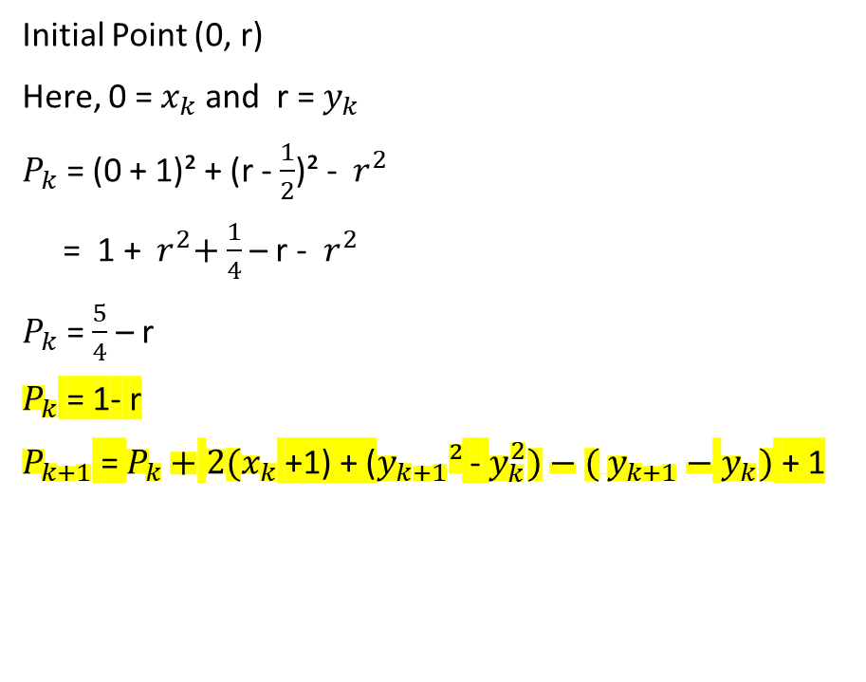
Initial Point (0, r)
Here, 0 =$x_{k}$ and r = $y_{k}$
$P_{k}$ = (0 + 1)² + (r - $\frac{1}{2}$)² - ${ r}^{2}$
= 1 + ${ r}^{2}+$ $\frac{1}{4}$ – r - ${ r}^{2}$
$P_{k}$ = $\frac{5}{4}$ – r
$P_{k}$ = 1- r
$P_{k+1}$ = $P_{k}+$ $2(x_{k}$ +1) + ($y_{k+1}²$ - $y_{k}^{2})−( y_{k+1}−$ $y_{k})$ + 1
If $P_{k}$≥ 0 then,
Next Point:
$x_{k+1}$ = $x_{k}$ +1
$y_{k+1}$ ${=y}_{k}−1$
And if $P_{k }$< 0 then,
Next Point:
$x_{k+1}$ = $x_{k}$ +1
$y_{k+1}$ ${=y}_{k}$

